Slide 1
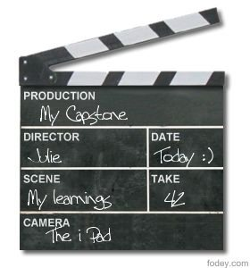
Video Presentation Storyboard
By Julie Kalvels
EDTC 610

Slide 2
“Hi, my name is Julie Kalvels. You have just entered my Capstone Portfolio Website. I’ve been on a mountainous journey plodding through each class, and now I’m at the top of the mountain. I’m almost finished and now I need to get back down the mountain by reflecting on what I’ve done. So as I ski down I will be looking back on each class I took at Regis and reflect how it has impacted me as a teacher.”
I will video tape this from the top of Keystone. I will then ski down and stop at various points holding up a sign that says EDTC 600, EDTC 601, etc. I will have a sign for each class. I will video each sign briefly coming in from different angles. One might be half covered in the snow and I will uncover it.

Slide 3
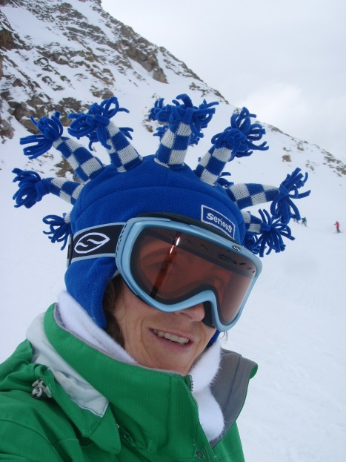
I will ski down a little and then start to hold up a sign that says EDTC 600 and then stop and say what is written below. Then hold up a sign that says (About Me).
“Oh! Wait, silly me. I haven’t told you about myself yet. First up– About me!”

Slide 4
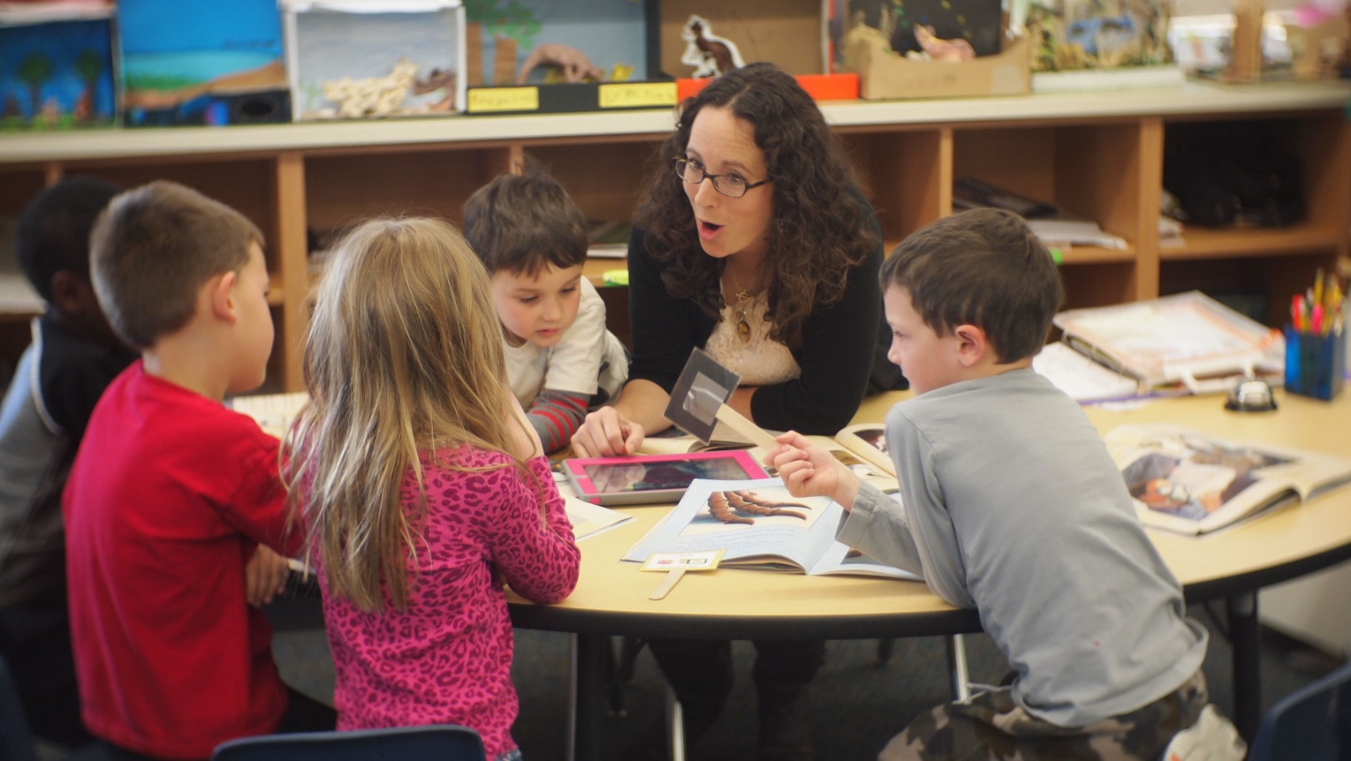
I teach Kindergarten at Bethke Elementary School in Poudre School District.

Slide 5
I am lucky to have lots of technology available in my classroom. We have a SMARTboard, a document camera, 4 computers, 2 iPads and a classroom amplification system.
Will have a video running in the background of Madison on the SMRART board and Sophie writing on the iPad.

Slide 6
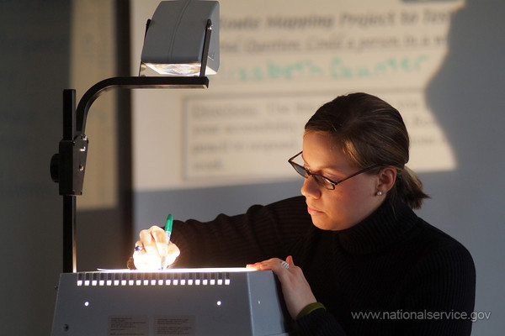
This is an improvement from the overhead projector and 1 computer I had in my room when I first started teaching 11 years ago.

Slide 7
But with all this new technology comes responsibility. How do I use it with my kids? How can two iPads transform my room? I felt like I was lacking the skills necessary to implement these tools successfully.

Slide 8
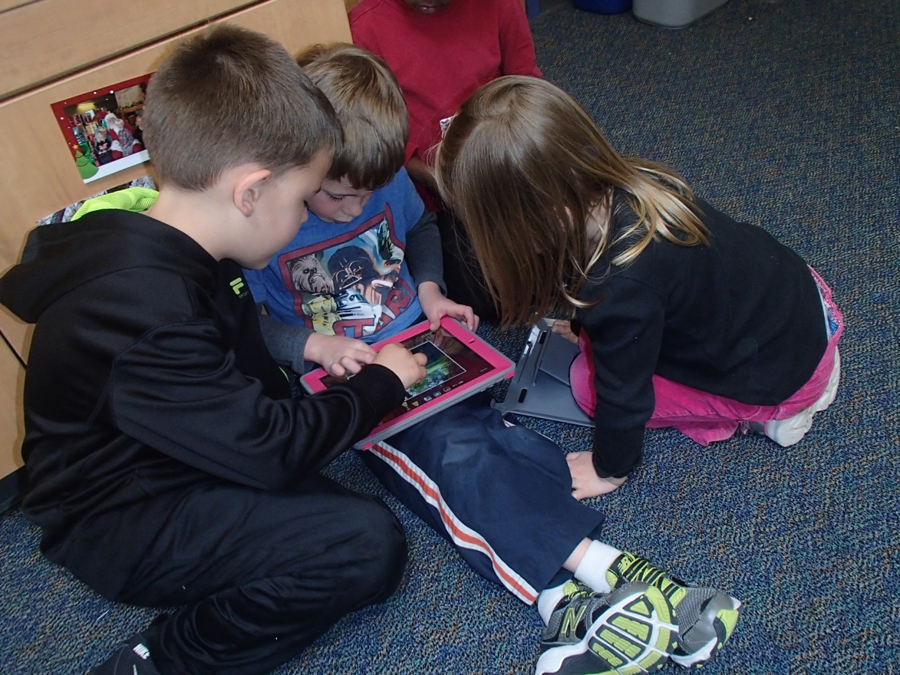
Every day my children were asking to use the iPad and go on the computers.

Slide 9
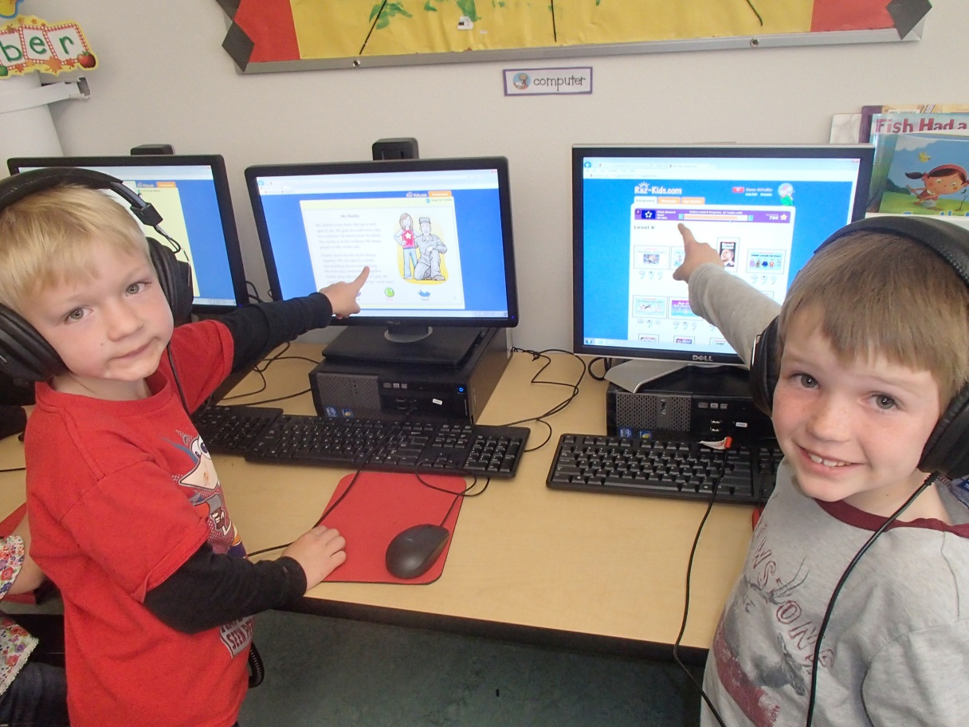
They would do anything for computer time. How could I use this passion for technology to enhance the subjects I teach?

Slide 10
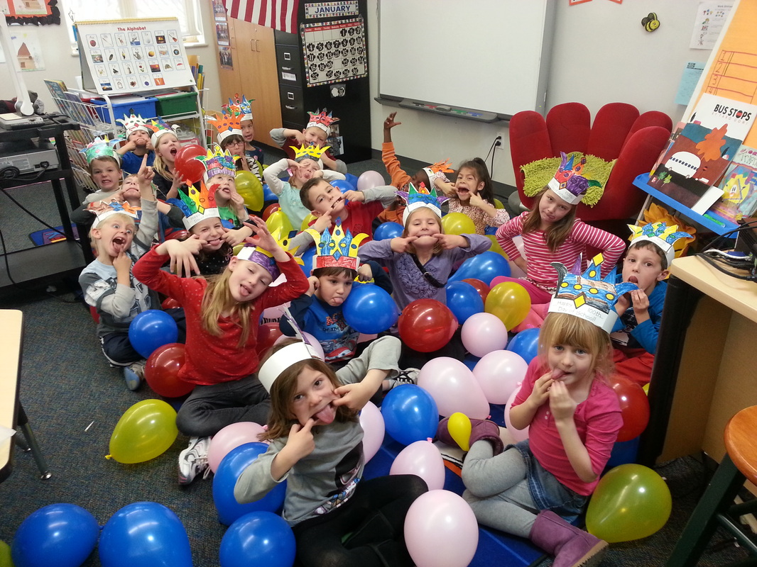
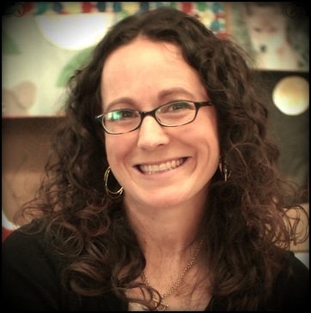
So I decided to go back to school and get my Masters’ in Instructional Technology so I could engage my students using technology and 21st century skills, which will make my classroom more exciting!

Slide 11
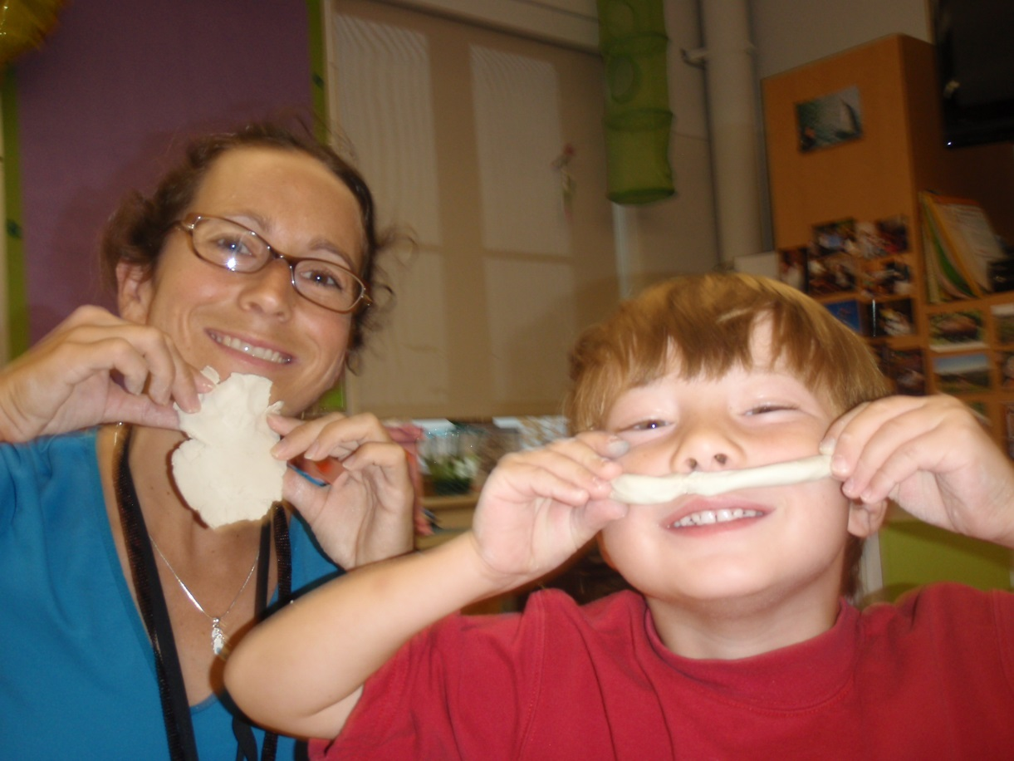
After all, who doesn’t like to have a little fun!

Slide 12
My first class at Regis was EDTC 600 Pedagogical Practice in Instructional Technology.
I will video myself holding up a sign (EDTC 600 Pedagogical Practice in Instructional Technology) saying the above message.

Slide 13
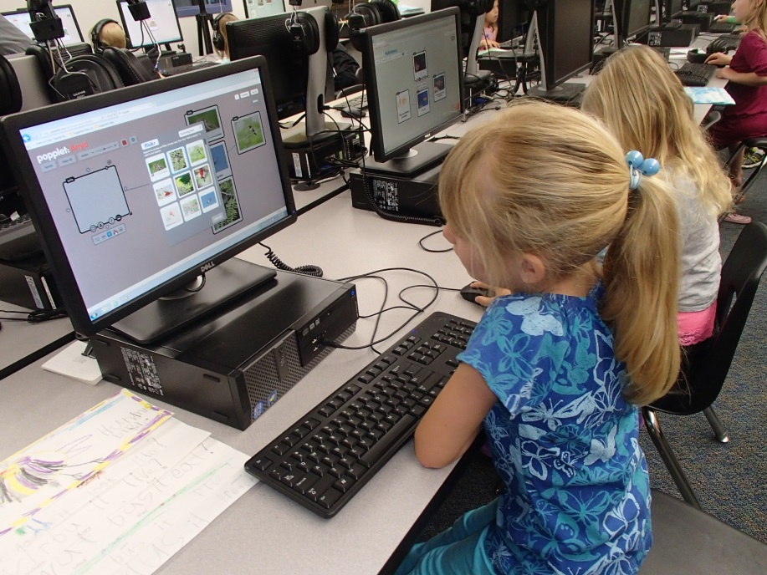
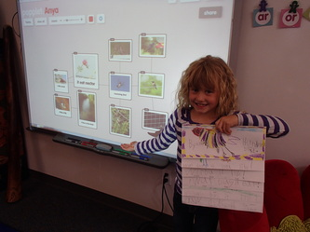
In this class I learned a valuable lesson about technology in the classroom. Teachers should not be using technology just for the sake of using technology. There must be a purpose and goal behind using it. Technology should enhance the curriculum already being taught, not just an add on the side.

Slide 14
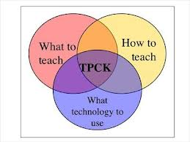
How is this done? The answer is TPCK. TPCK combines technology, pedagogy, and content knowledge to help teachers create powerful lessons.

Slide 15
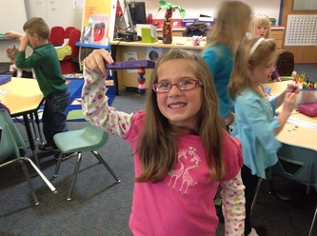
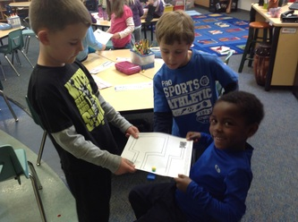
Technology is a wonderful enhancement, but it’s not always the most effective tool in every situation. Like when your testing what magnets stick to and if they work through paper.

Slide 16
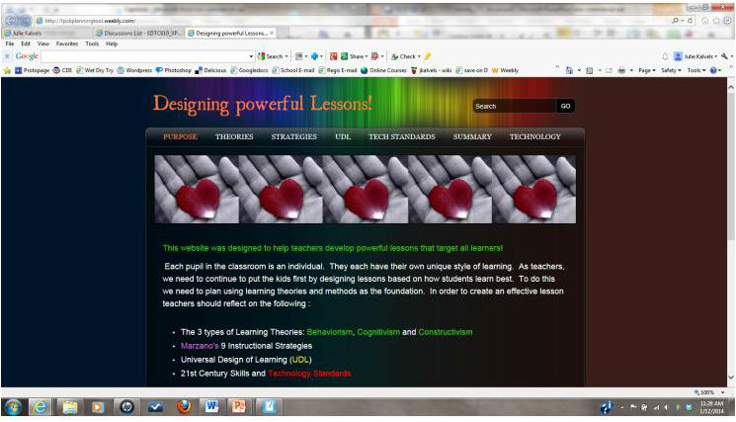
In this class I created a website to host all of my research on TPCK. It is a one stop shop I can look at when I’m creating lessons. It contains the UDL guidelines, Marzano’ nine instructional strategies, the three learning theories and the technology standards. All the pedagogy I need to create dynamic lessons with TPCK in mind.
I will create a brief Screencast displaying the site. The video will be playing while I read the above statement.

Slide 17
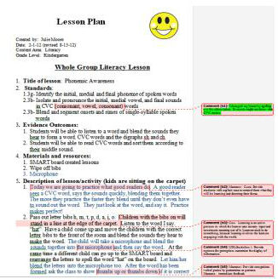
Another valuable activity I did in this class was take an existing lesson plan and revised it while commenting on the side explaining when the activity applies to Marzano’s nine strategies, UDL or the constructivists theory. This assignment opened my eyes to how much I was already using TPCK in my instruction without even knowing it. To be honest, it’s just good teaching! Many times I write lesson plans and teach lessons and don’t go back to reflect why I choose to do something a certain way. By having learned about TPCK and dissecting different parts and applying them to my lesson it has allowed me to fully understand just how much TPCK can enhance my children’s abilities to learn.

Slide 18
Hi again, Weeee! This is fun! Next up on my downhill reflection is EDTC 601Virtual Communication and Collaboration.
I will video myself holding up a sign (EDTC 601 Virtual Communication and Collaboration) saying the above message.

Slide 19
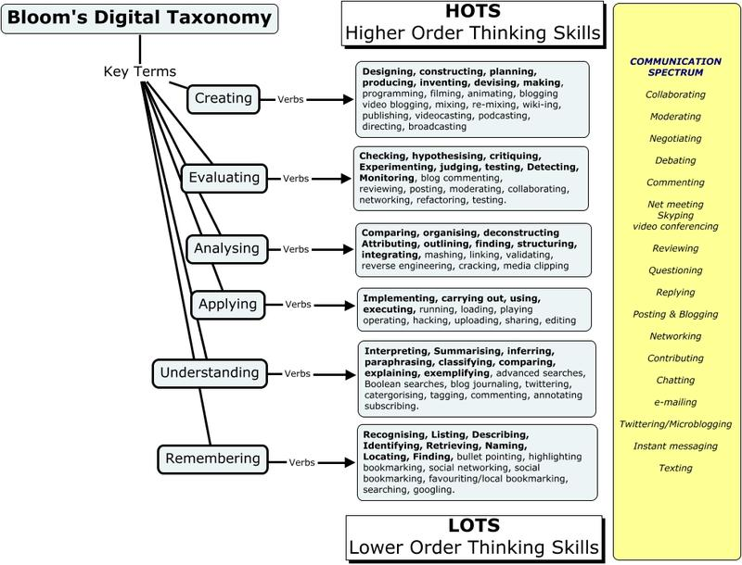
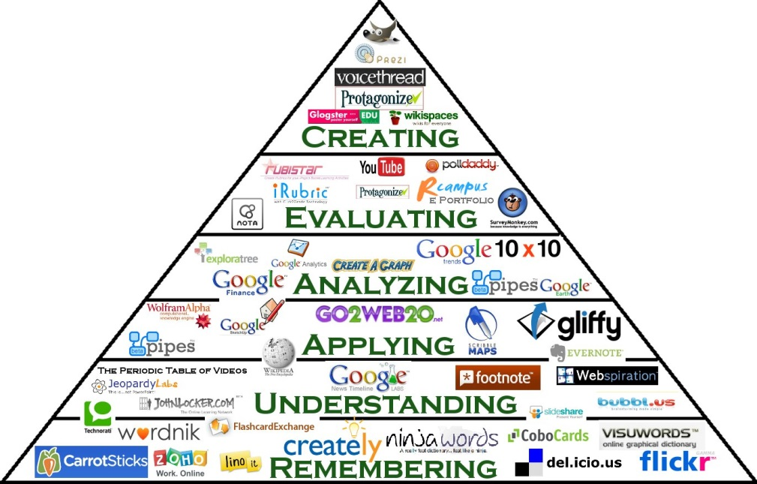
This class was a whirl wind of one learning opportunity after another. I learned that Blooms Taxonomy of Higher Order Thinking Skills has been adapted to include verbs from our digital age. I reflected on how technology lends itself to these higher level skills. This reminded me that children learn best when they apply what they’ve learned to create something new.

Slide 20
I learned a new presentation program called Knovio. I was able to share my Blooms Taxonomy PowerPoint presentation while recording my voice, picture, and slides at the same time. I could see myself using this program with my Kindergarteners to teach letter sounds and the actions that go along with those sounds.
Insert a screen cast of Knovio!

Slide 21
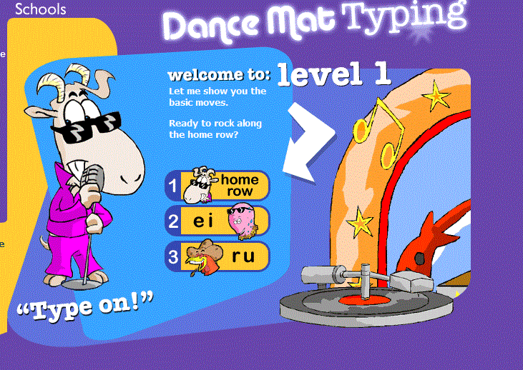
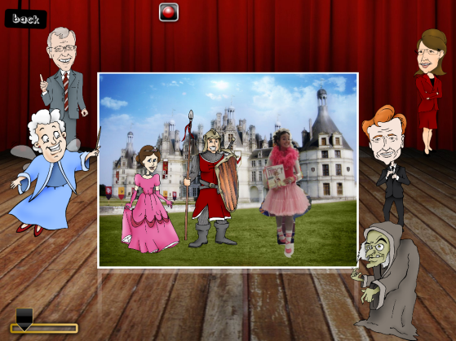
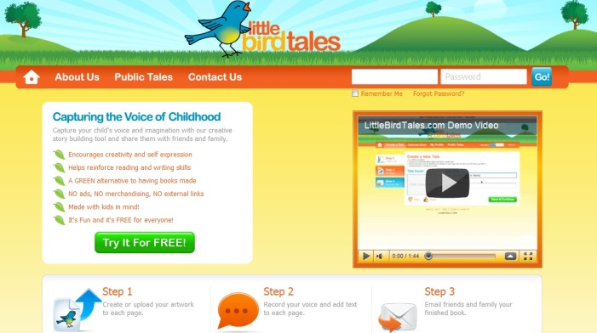
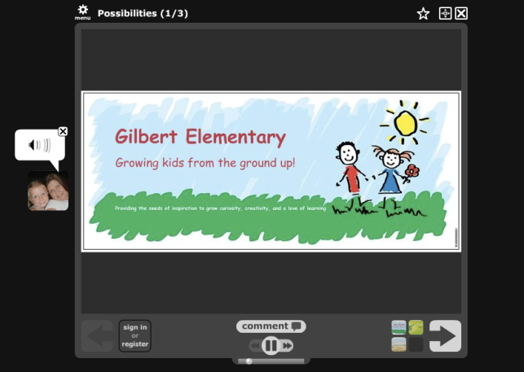
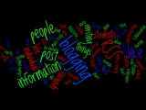
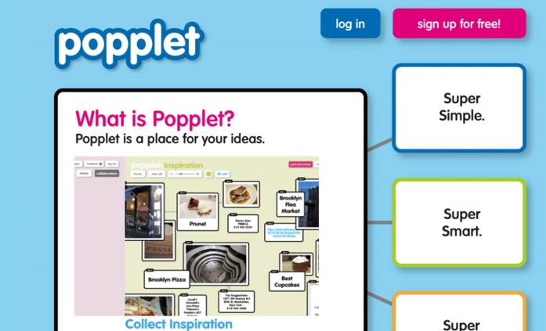
I uncovered many tools even Kindergarteners could use that promoted Blooms higher level skills like Puppet Pals, Dance Mat Typing, Voicethread, Popplet, Wordle, Little Bird Tales, Fotobabble, and Kidblog. By applying Blooms to my lessons though these tools I can create an environment where students deepen their understanding of knowledge along with their understanding of themselves as learners.

Slide 22
Here is a sneak peek into my classroom to see how I’ve implemented some of these new tools. Before school started I sent this fotobabble to all my parents.
Screen-cast-o-matic of Fotobable

Slide 23
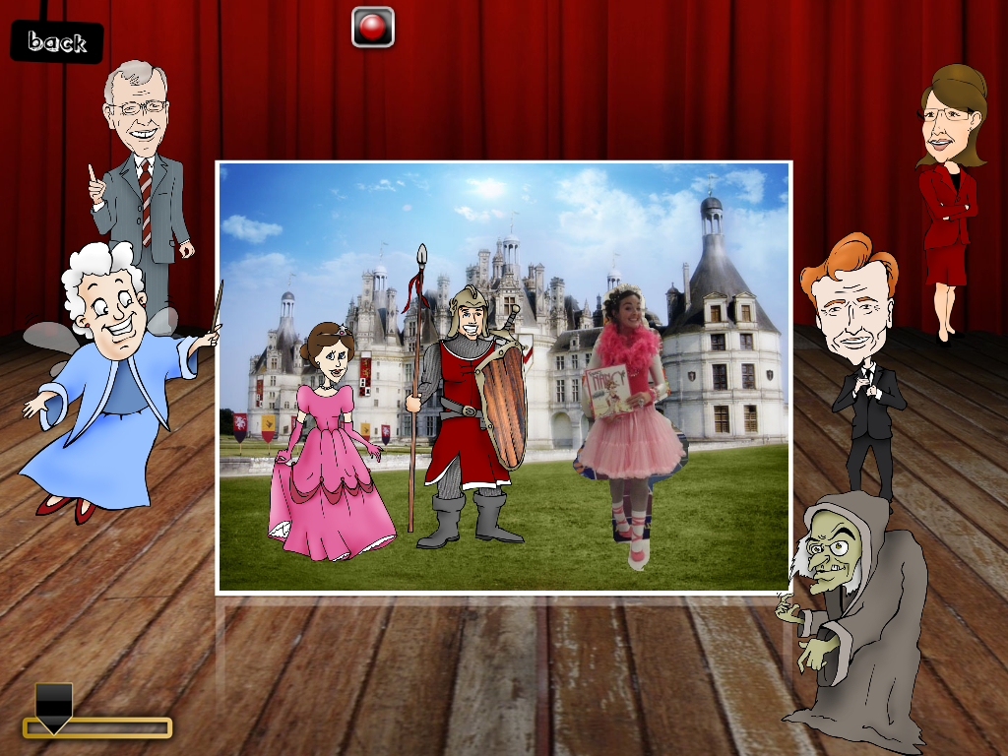
My students love to use their imagination making up stories on Puppet Pals.
Video of a puppet pals recording by Kellan in my class.

Slide 24
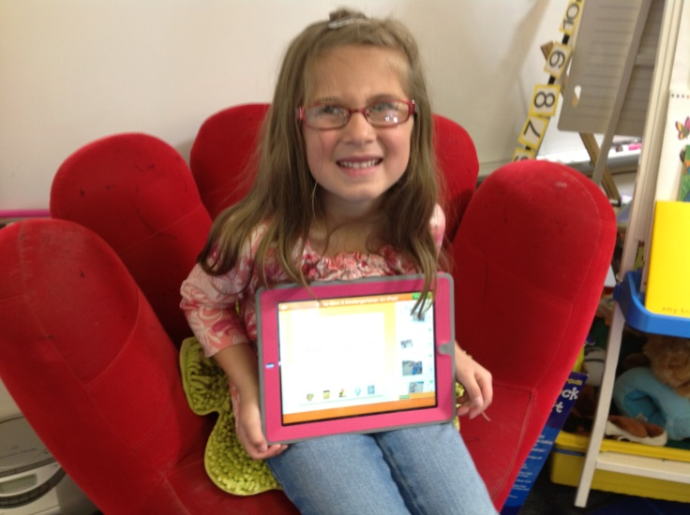
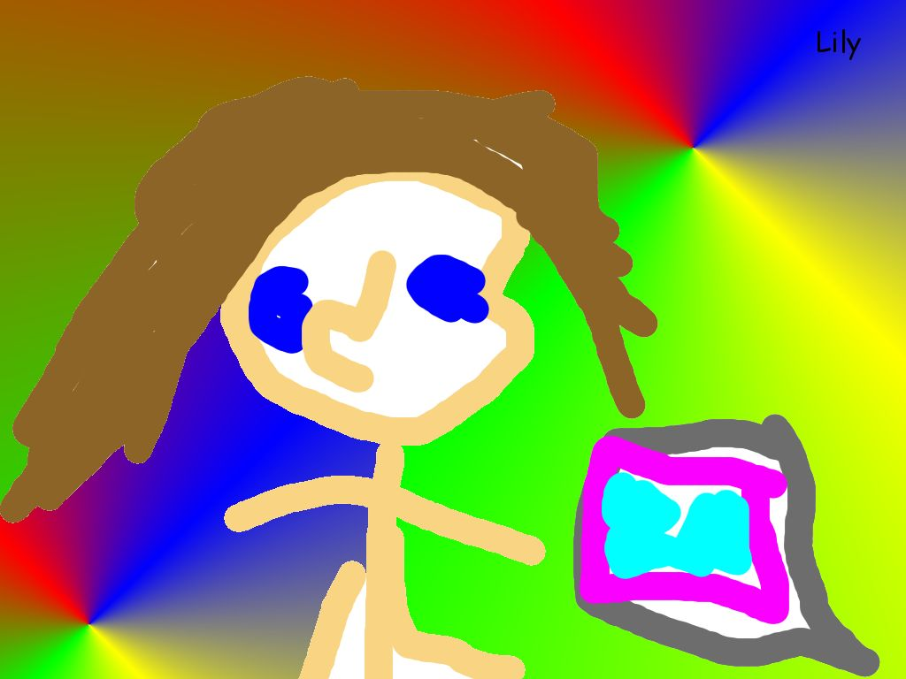
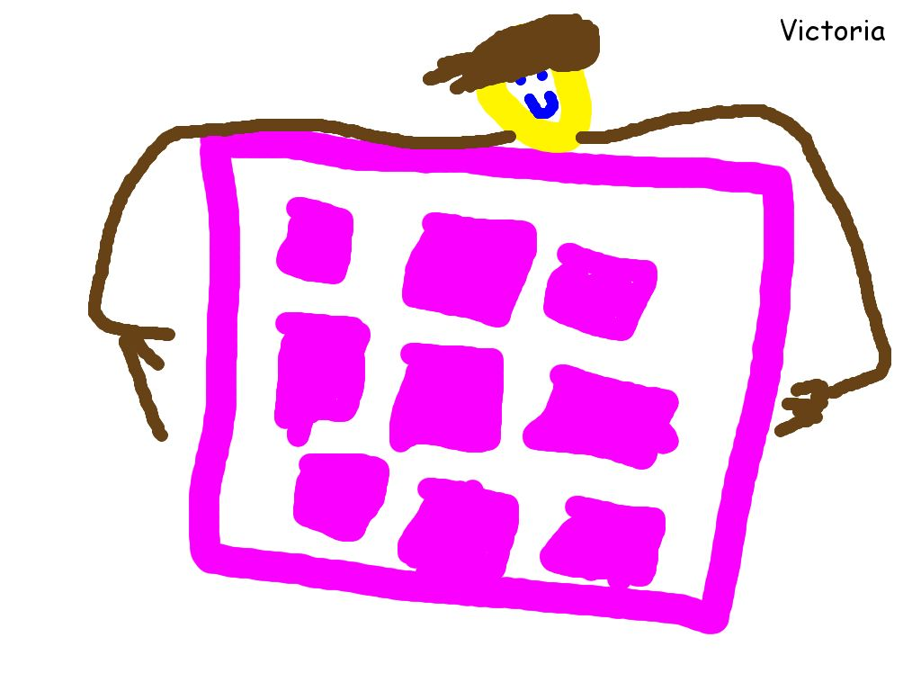
We created a class story on Little Bird Tales of what would happen if you give a Kindergartener an iPad. This was the first time my kids have ever recorded their voice. We talked about how to speak loudly and clearly into the microphone.
Video of Little Bird tales story

Slide 25
After exploring magnets around the room they shared their learnings on Voicethread.
Screencast of Voicethread here.

Slide 26
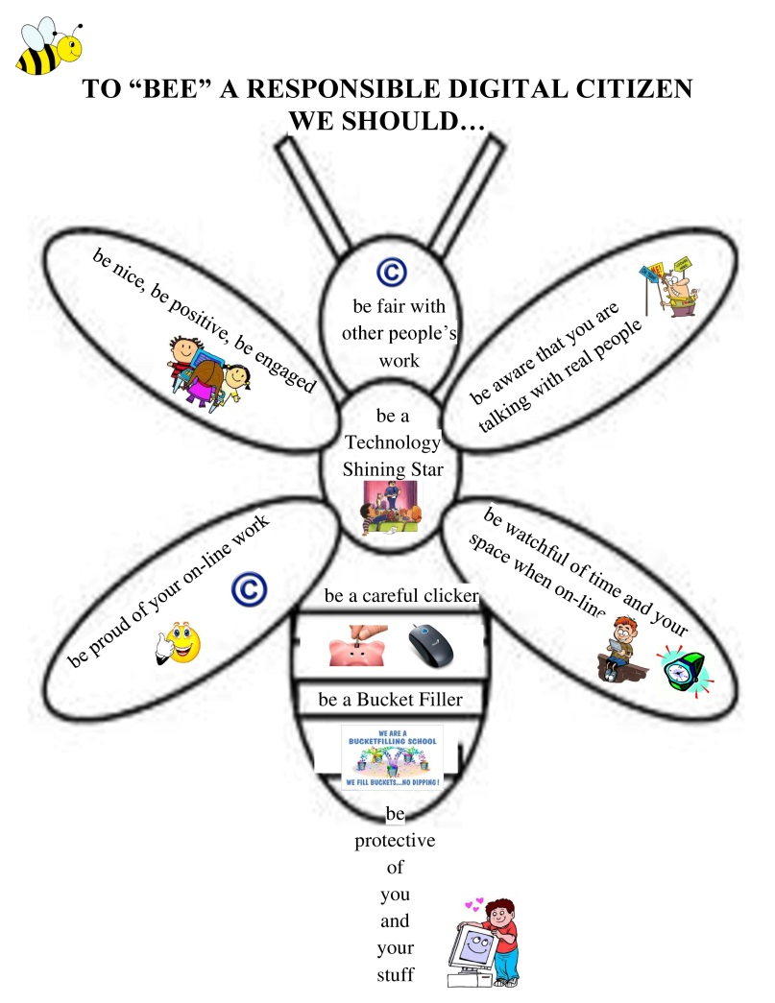
In this class I also learned about Digital Citizenship and that it’s never to early to start teaching about responsibility on the Internet. I created this poster with one of my colleagues. We used Google Docs, Google Chat and Word to communicate and simultaneously created a child friendly poster teaching Digital Citizenship to our Kindergarteners.

Slide 27
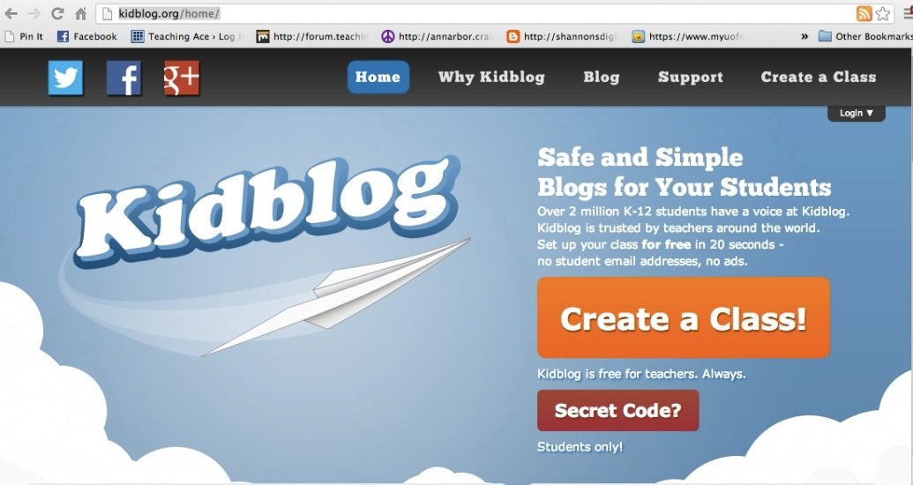
This course has been a real eye opener for me. I came to realize that technology can enhance any grade level! I am a Kindergarten teacher and I was a little concerned that I would be learning lots of really neat Web 2.0 tools, but not be able to use them in my classroom. As you can see from my videos I was incorrect, because even the little ones can create podcasts, blogs, wikis and contribute to publishing videos. I watched a video of a Kindergartener telling why he enjoyed blogging. It inspired me to think, yeah, why not! This research has impacted my teaching by giving me tons of great ideas of how I can blog in my own classroom. One of my goals this year is to become blogging buddies with Mrs. Moran’s Kindergarten class, another teacher I met through my Regis classes.
********************Get pic of Kinder class!!!!!*********************
Screencast of my Kidblog page

Slide 28
My next class is EDTC 602 Instructional Design. You may be wondering why my husband is skiing backwards. Here’s why!
I will video Erik holding up a sign (EDTC 602 Instructional Design) saying the above message.

Slide 29
This was one of my favorite classes because I created a backwards design unit about animals and their needs. By teaching with my end learning goal in mind, I was able to make sure all of my learning activities led to the overall goal. It was also fantastic developing lessons that I could teach to my students. I learned how to develop a context map and a theory of action. I learned how to analyze content standards, 21st century skills and NETS, which allowed my students to dig deeper into their own thinking.
Screencast of backwards design unit

Slide 30
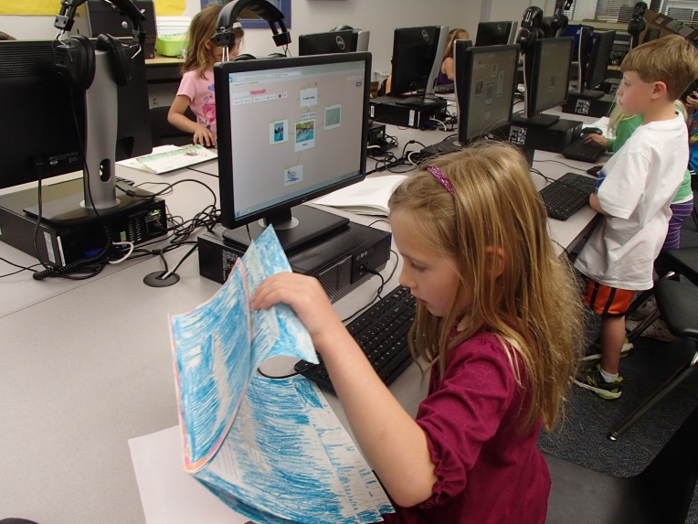
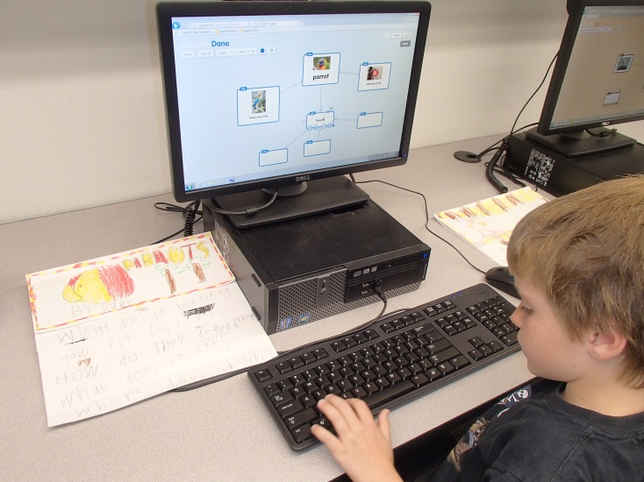
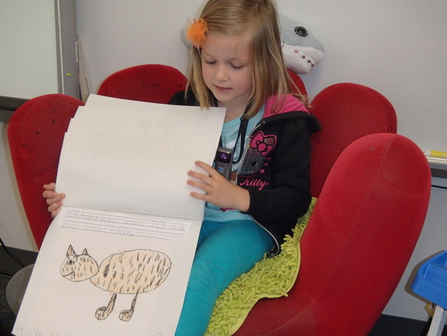
And boy what a terrific impact it had. The animal research project at the end was a HUGE success.

Slide 31
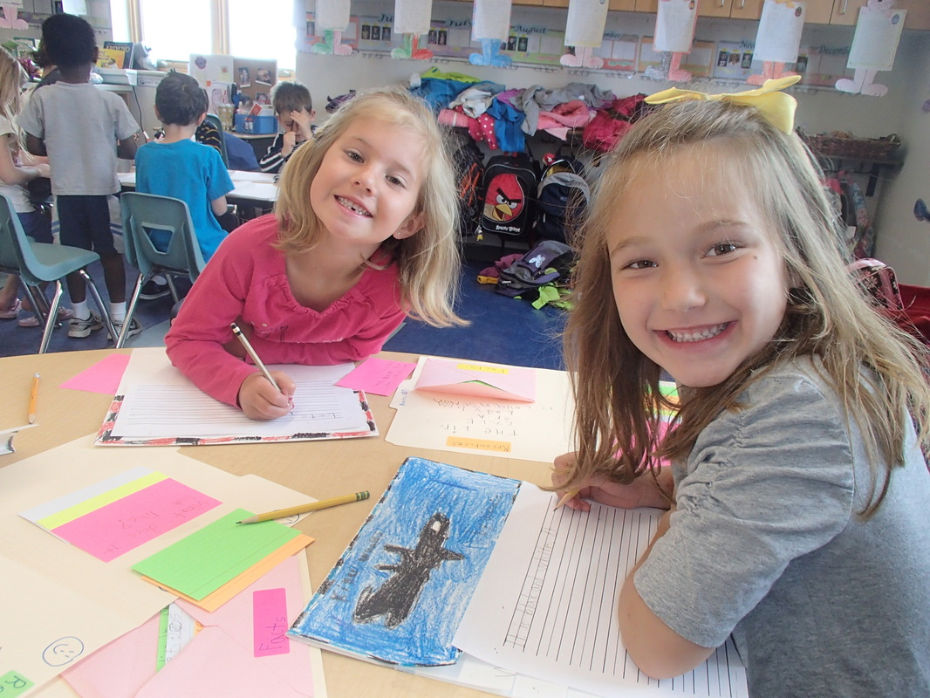
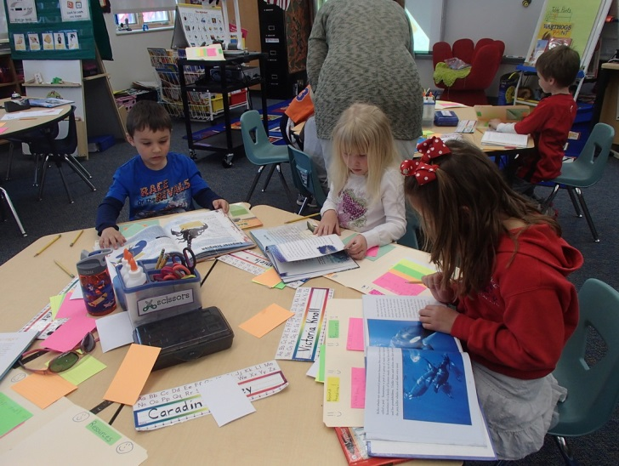
It was a tall order, but my Kindergarteners rose to the task. They researched an animal of their choice and created a flip book and Popplet so they could teach each other about their animal.

Slide 32
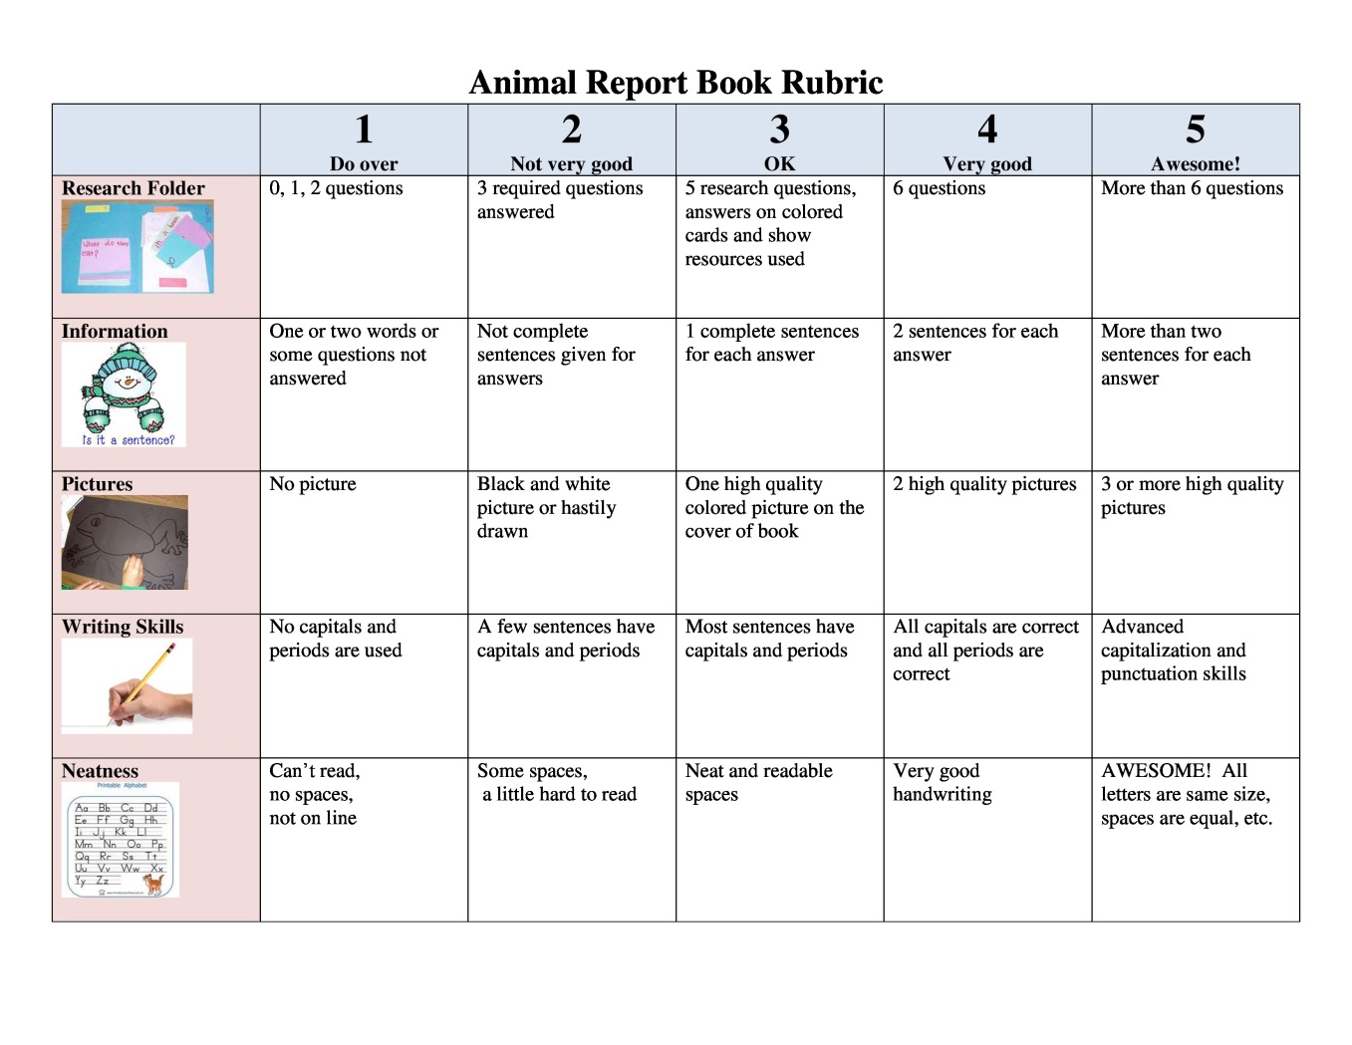
As a class we created a Rubric so my students knew my expectations on how they would be graded. It’s also a great way to provide feedback- one of Marzano's Nine instructional strategies!

Slide 33
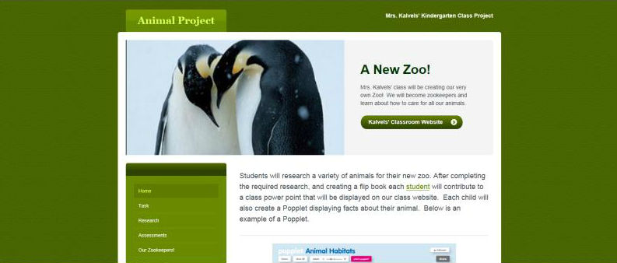
I also created a website for our animal research project culminating activity. I explained the project using this Voki.
Screencast: Voki description

Slide 34
The website has a research page with links that the children can use to access kid friendly information about their animal. It also has pictures of my student’s homemade Popplets. I always strive to create fun cross curricular experiences that will motivate, challenge and excite my students to do their best. This lesson did just that!
Screencast of Animal Website

Slide 35
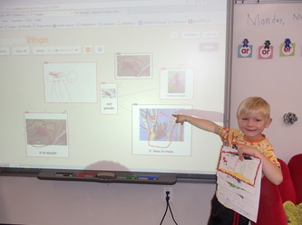
Using technology helped my students discover facts about animals on their own, rather than me reading a book and them being passive listeners. They went home and showed their parents and even grandparents in different states their Popplet creations.
Video of Dane sharing his report and Popplet

Slide 36
What do we have here! Oh my next class. Let’s uncover this. What is this a Web! That’s ironic, this is my EDTC 603 Web Development class reflection after all!! Ummmm????
I will have the sign buried in snow with white web covering it and uncover it (EDTC 603 Web Development) saying the above message.

Slide 37
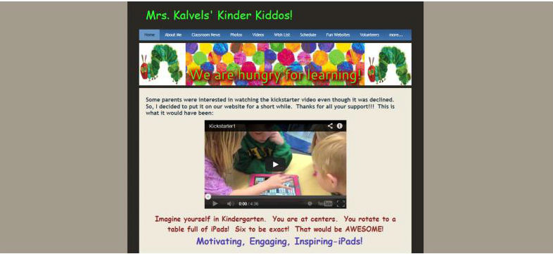
I was excited to take this class because I wanted to learn more about what I can do to make the classroom website I had even better.

Slide 38
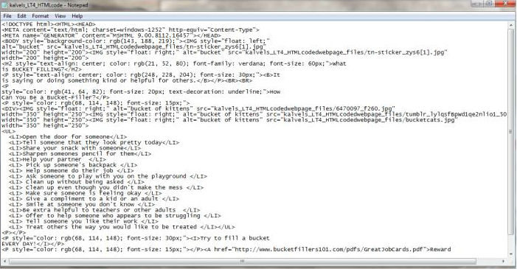
Through exploring source code, HTML, and widgets I was better able to understand the elements that go into a website.

Slide 39
I even wrote my own source code to create a page. It was a struggle in itself, but after watching many tutorials I was able to make it happen. I am now able to manipulate the size and color in a website.

Slide 40
I created the classroom website I am now currently using with my class. I designed it with all the elements I learned such as the f-stop design, knowing your audience, utilizing syntax and typography. I used Weebly as my host. I learned how valuable websites can be for teachers. On my website parents can assess bi-weekly newsletters, volunteer schedules, pictures, videos of children learning and educational websites. My students use my website every day in our daily centers to access a link to an online reading program called Raz-kids. What I find valuable is that they then go home and know exactly how to access it from home too!
The children have a student blog section where they are creating a Voki about themselves.
Screencast of website
Screencast of Volki

Slide 41
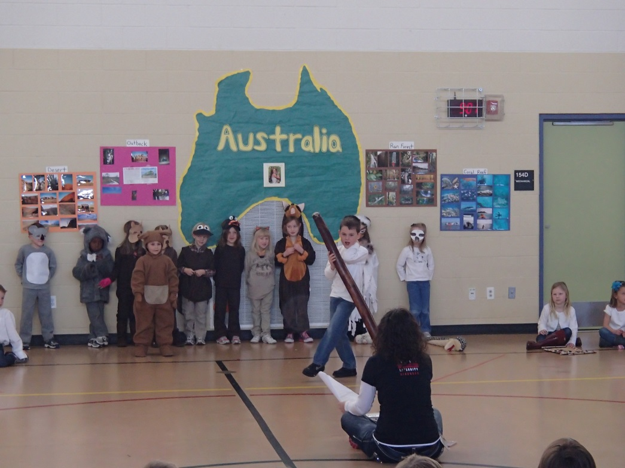
Each year my children star in an Australian play that I wrote. Last year I posted the video on my website and within two weeks I received an email from a teacher in Australia saying that she loved our video and showed it to her kids. WOW! My kids were ecstatic!
Screencast of Aussi Play

Slide 42
Next up EDTC 605 Multimedia
I will video myself holding up a sign (EDTC 605 Multimedia) saying the above message.

Slide 43
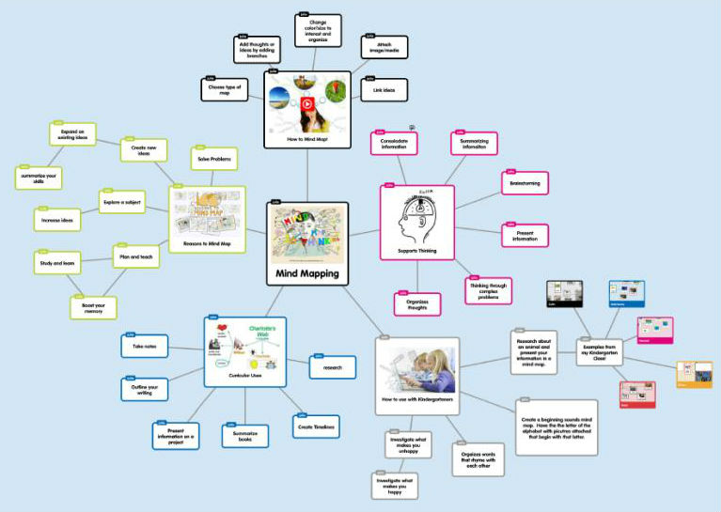
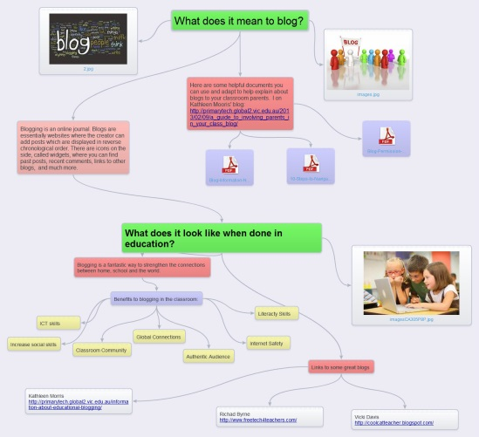
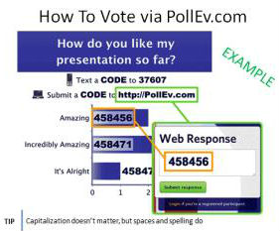
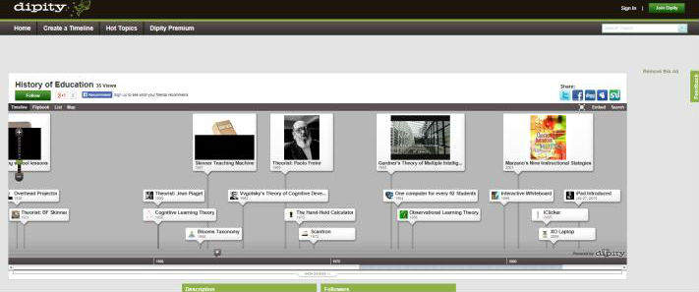
Throughout this class we completed many assignments using new tools that I can one day incorporate into my classroom. We created mind maps using Popplet and spidercribe. We explored the use of cell phones in the classroom. We even created a Poll using “Polls everywhere.” We also created a timeline on the history of education using a new program called Dipity. This is a great visual tool for kids.

Slide 44
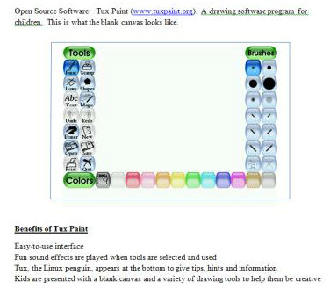
I found out about Open Source and even created a presentation about the pros and cons using Prezi. I also created a video explaining how to use one of the applications I discovered called Childsplay.
Screencast of Childsplay

Slide 45
My favorite part of this class was creating a presentation on blended learning and how it could look in a Kindergarten classroom. My answer is iPads! Managing 20 plus Kindergarteners who seek individual attention is not an easy task. By adding iPads or computers to a station where children rotate during literacy centers, is a step in the right direction. Instead of children being at an independent center playing games with no feedback (and a chance to be off task ) they can be highly engaged using drill and practice software to practice phonics, math and handwriting. The teacher can then use generated reports to identify strengths and weaknesses. This will allow students to move at their own pace and at their own level of instruction.
Screencast of Blended Learning Prezi

Slide 46
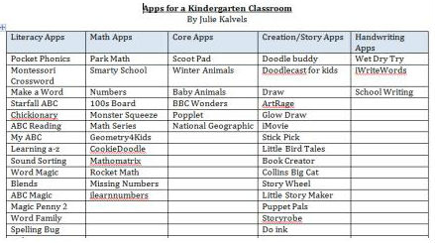
I also found some awesome apps that I could use with my Kindergarteners. Slowly throughout the year I tested them out with my kids to consider if it was a keeper or not.

Slide 47
Some favorites were Glow Draw, Magnets, Chickionary, and Spelling Bug. The children loved testing the apps!
Video of Sophie writing a sentence in Glow Draw.
Video of Dane writing HFW on magnets.
Ethan on Draw writing a math number sentence.

Slide 48
The idea of blended learning, and using iPads in the classroom has impacted the way my classroom looks and feels. What I discovered once I actually had an iPad was the power of the video camera and an app called iMovie!

Slide 49
With one iPad I transformed the learning in my room. I videoed children learning, reading, teaching others, and I posted them on my classroom website. For example, I videoed them holding up letter flashcards, and teaching the letter sounds and actions. In one month, I had 225 hits on the video section of my website. They loved watching themselves. This caused them to learn their letter names and sounds faster!
Video of Reading Strategies.
Video of Letter Names and sounds.
Video of reading strategies talking and then mute it and say the above message. Switch video to letter names and sounds muted but at the end listen to one or two.

Slide 50
It wasn’t just the parents using my website to learn about my classroom, but the children were using it to learn and view themselves! It inspired them to want to write better and produce a higher quality work so I would pick them to be in a video. There was something magical about the iPad camera. The idea of posting videos to my class website to reinforce what we are doing in the classroom was a brilliant idea. In a way, it’s like the flipped classroom for the Kindergarten classroom!
Video of Poems
Video of Dinosaur Writing

Slide 51
Next up EDTC 606 Multimedia 11. Don’t worry no one was hurt in the filming of this movie.
Hold this sign while on the ground pretending to have fallen (EDTC 606 Multimedia 11) I will say the above message.

Slide 52
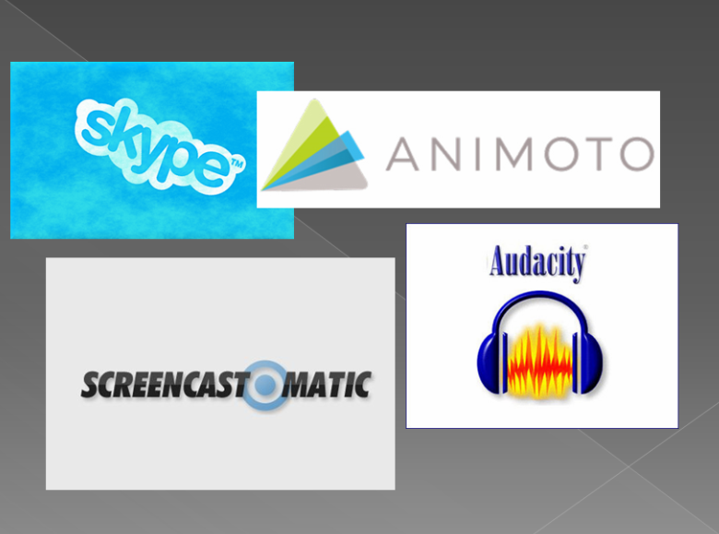
I learned an incredible amount of new technology and it’s applications to my classroom in this class. Animoto, Screencast-o-matic, Audacity, and Skype were a few of my favorites.

Slide 53
Making remix videos was a new experience. I found a great tool in Animoto. Combining video clips, photos and music has never been so easy. We had just studied about the US symbols and had our US symbols day in class. I created this video to display what we did in the classroom and to reinforce information that we studied about these US Symbols. I put it up on our class website and the kids, parents and grandparents loved watching it! Even a month later during Friday Fun day I saw some kids on the computer on the website watching the video. What a great way to reinforce the US symbols, even months after studying about them!
Video Remix of US Symbols

Slide 54
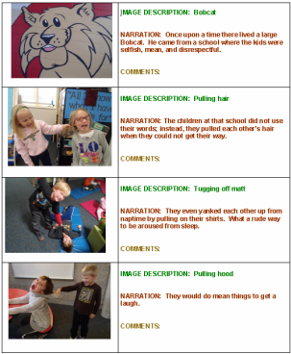
I learned how to create a storyboard and create a digital story using pictures in iMovie. I created a story with the help of my students. It’s called “How the Bobcat Got Its Name.” The most challenging part of iMovie was figuring out how to zoom in and out on the photos the way I wanted. Once I finally realized how to do it, it was no trouble at all. While making this video it hit me that we really do learn by doing and having direct interaction with the content. This is nothing new, I know this constructivist approach to learning and have my kids “doing” all the time, but I didn’t realize how true it was until I created this movie. The video teaches our schools four character traits of respect, responsibility, integrity and kindness. After making the video, I now use these character traits by name more in my class. For example, when someone comes in and hangs up their backpack and chooses their lunch, I praise them for being responsible. I learned more from creating the video than I would have if I had only just watched a video. Does this sound familiar? Blooms highest level of thinking, creating!
Video of digital Story running in the background.

Slide 55
In this class, I discovered how to create podcasts using Audacity. Here is a sample of a podcast I put on the volunteer section of my class website.
Well, you get the idea. It was so much fun to create. My kids laughed and laughed. And eventually started making up their own songs to what the fox says. In the future I can envision my kids creating their own podcasts too. What a great tool to help develop reading, speaking and writing skills.
Screencast of podcast on my website.

Slide 56
My next reflection is on EDTC 614 Integrating Technology into the Curriculum.
This sign will be posted on a tree. (EDTC 614 Integrating Technology into the Curriculum) saying the above message.

Slide 57
My understanding of technology integration has had a major impact in the setup of my daily center rotations and classroom instruction. In one of the online lessons I critiqued, I learned a new strategy on how to use the computers effectively, even if you only have a few computers. I now rotate my computers as part of my daily literacy centers. When it is time for the children to rotate to table number two, the alternate each day who is on the computer. So in a week I have every kid in my class going to the computers for two 20-minute sessions.
Do not have yet but will take:
Video of Table 2 rotations and a picture of our rotation chart.

Slide 58
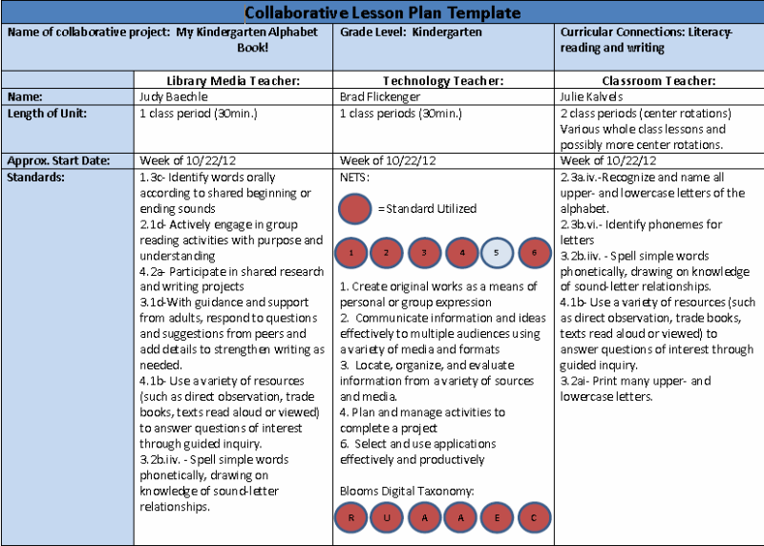
This class allowed me to create many lessons integrating technology. In one particular lesson I created a Word Family book that went along with playing a game on the computer. The kids loved rotating to a computer during our morning work stations. The book gave them a purpose for playing the game, and afterward I had evidence of what they learned.

Slide 59
The rubric on the back of each page was an excellent way for my kids to stop and reflect on the sentence they wrote. After they finished their book, they got together with their book buddies and read words to them. The book buddies then had some reflective questions to ask. The kids loved showing their book buddies what they had been learning.

Slide 60
I learned the importance of keeping children accountable and having high expectations. Rubrics are great way to do this! I created this work station rubric together with my kids. It is a visual representation that hangs in the front of my class. I refer to it every once in a while when my students need a reminder of my expectations during centers. I think rubrics are a great assessment and self-reflection piece. It gives my students more responsibility and ownership of their work.

Slide 61
The bookmarking site Protopage has been an invaluable tool. I add and refer back to these bookmarks on a daily basis. There is so much on the Internet, and my Protopage is an excellent way to organize and make sense of it all so I can go back and use them when the time is right!

Slide 62
Electives time! My first elective was EDRG 602 Reading and Writing Connections.
Extreme close up. Zoom in close and back and in again. I will video myself holding up a sign (EDRG 602 Reading/Writing Connections) saying the above message.

Slide 63
In this class I leaned that the writing process is not always linear. There is not one formula or process that works for every person. Writing is unique to each individual.

Slide 64
I created a journal entry each week of this class. It taught me something about myself as a writer. When I first read that I was going to have to keep a writers notebook, I was a little turned off and thought of it as “work.” Each week I scrolled back through my previous writings and I was proud of them.
Screencast of writers notebook

Slide 65
I created many lessons including a shared writing lesson on How to Fill a Bucket. After writing I took pictures of their work and uploaded them to Little Bird Tales. The kids then recorded what they wrote, and we created a class book of what fills their bucket! When I showed the video they were so quiet and in awe!!! One child said, “Can we do it again?” Another one said, “Hey, we can make an ABC book like Chicka Chicka boom boom, and put it on there too.”
Video of how to fill a bucket

Slide 66
Another elective was EDRG 644 Teaching Reading and Writing.
I will video myself holding up a sign (EDRG 644 Teaching Reading and Writing) saying the above message.

Slide 67
In this class, I created a Scope and Sequence of Phonemic and Phonological Awareness for a Kindergarten classroom. Since I teach Kindergarten, this schematic is near and dear to me. Every morning during literacy instruction we cover one of these skills, so it is helpful to my teaching to be able to break each of these skills apart and give examples of how they can be implemented in a classroom.

Slide 68
Assessment guides my instruction. I learned of a new assessment called the CORE Phonics Survey by Scholastic. I used this assessment with one of my high readers. Our reading program has phonetic skills for low, on-level and beyond leveled readers, but some of my kids are even above the beyond level. This assessment can teach me the strengths and weakness of my higher readers and what I as a teacher need to focus my instruction on.

Slide 69
I kept a detailed journal of my experience with administering and interpreting the results of a DRA test I gave to a student while another colleague observed. I enjoyed collaborating with another one of my Kindergarten teachers. The hardest part of assessing is interpreting the data and deciding on the next steps. It was helpful to bounce ideas off of each other and talk about the next steps. Once again this shows the power of collaborating.

Slide 70
I’m almost to the bottom! Last up is my last class at Regis EDTC 610 Instructional Technology Capstone Project.
I will video myself holding up a sign (EDTC 610 Instructional Technology capstone Project) saying the above message.

Slide 71
This class gave me the opportunity to summarize all my learnings throughout the past year and a half at Regis. This video and my capstone website is a result of this mammoth reflection. It has certainly been an inspiring journey!

Slide 72
My lessons now reflect my new learned skills and I am a better teacher because of it!

Slide 73
I want to give a big thanks to my husband, Erik, my family and colleagues at Regis for encouraging me along the way, and helping me to accomplish my goal.

Slide 74
Yeah! I’ve reached the bottom! I can now graduate!
Throw up my graduation hat at the bottom of the hill!!!

